Slide 1

Experimental Mechanics Sym.
Cambridge, UK July2014
Micro-structural adhesion in
bio-composite materials during
their heated consolidation
Philip Humphrey
Adhesive Evaluation Systems, Inc.
Corvallis, Oregon, USA

Slide 2
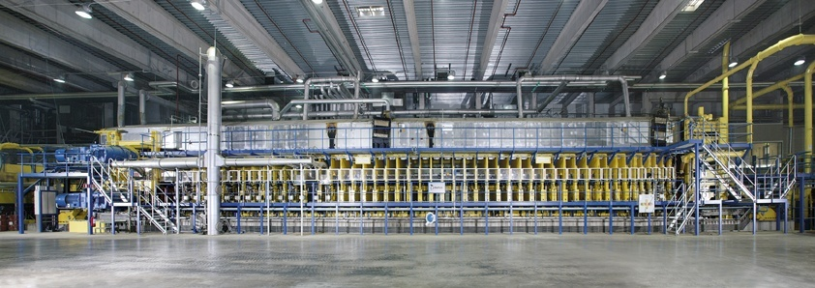

Continuous hot press for wood-based panels
Notes:
Our Motivation: Understand mechanisms relevant during consolidation of bio-based materials, ...
... like here in a continuous industrial production.
Prozess kurz beschreiben!
Our interest: Physical processes inside the mat.

Slide 3
Mechanisms operative during pressing
Predicting internal conditions
The need to optimize adhesion dynamics
The ABES approach
Adhesion in space and time
Implications
What we will discuss

Slide 4
Hot Press
Pressure
Hot Platen
Heat
GAS
Heat
Hot Platen
Pressure
Notes:
There are a lot of mechanisms happening within the mat:
Due to the high temperatures of the pressing platen, heat and moisture is moving towards the center of the mat.
At the same time, the mat is going to be compressed...
… and water vapor and air is escaping through the edges of the mat.
The glue that was given to the particles before cures,…
… and the properties of the mat are changing with time.

Slide 5
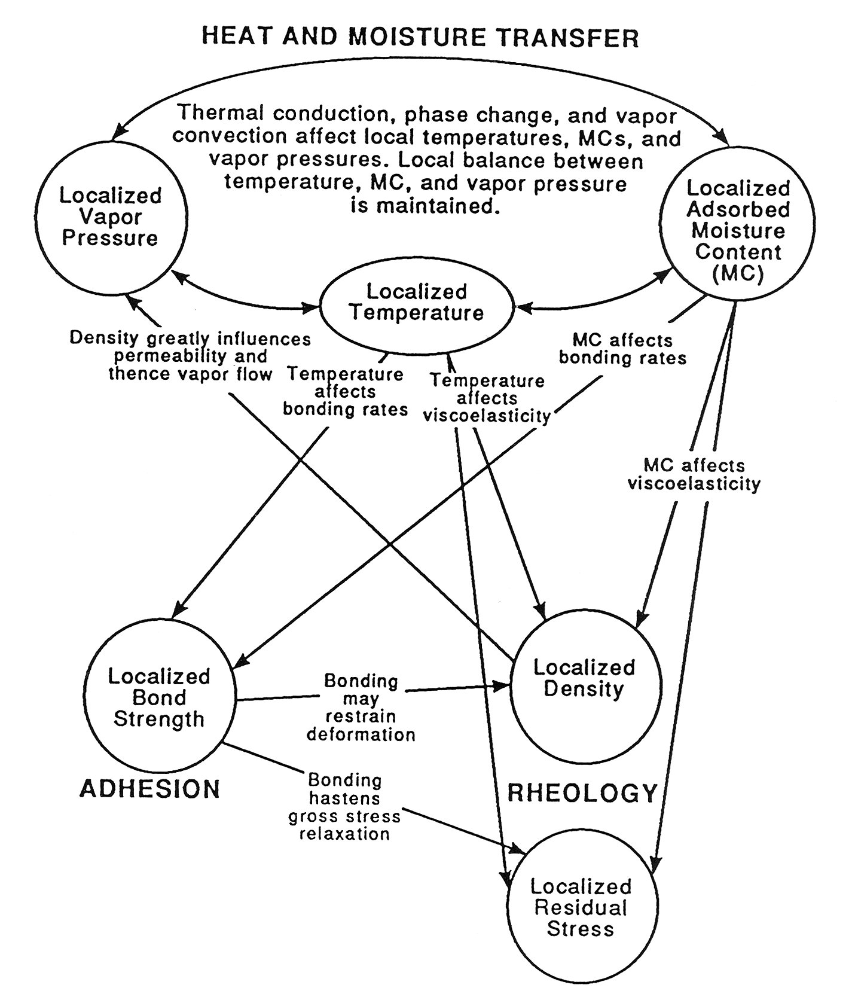

Mechanisms during hot pressing
Thermodynamics
Adhesion
Rheology

Slide 6
Mechanisms during hot pressing
Thermodynamics
Adhesion
Rheology

Slide 7
Mechanisms during hot pressing
Thermodynamics
O
Rheology
O
Adhesion
C
H
N
C
H
N

Slide 8
Mechanisms operative during pressing
Predicting internal conditions
The need to optimize adhesion dynamics
The ABES approach
Adhesion in space and time
Implications
What we will discuss

Slide 9
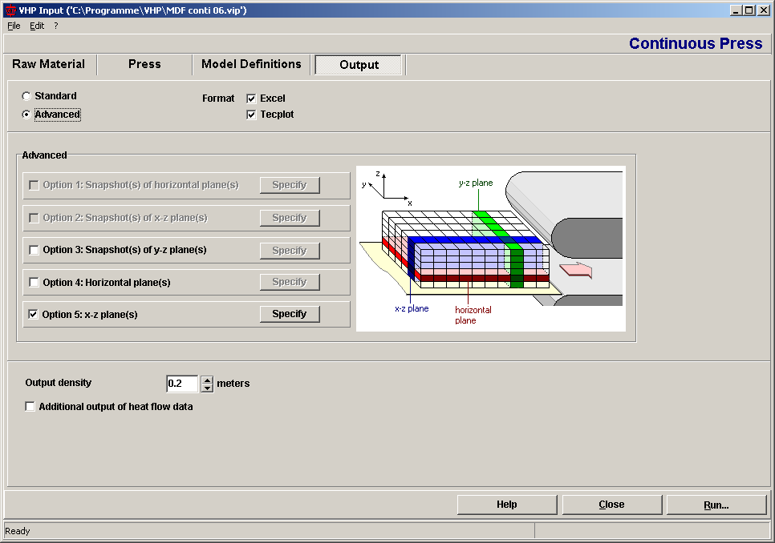


Simulating the pressing process – a tool
Project partners:
University of Hamburg
Adhesive Evaluation Systems
Siempelkamp (Krefeld, Germany)

Slide 10
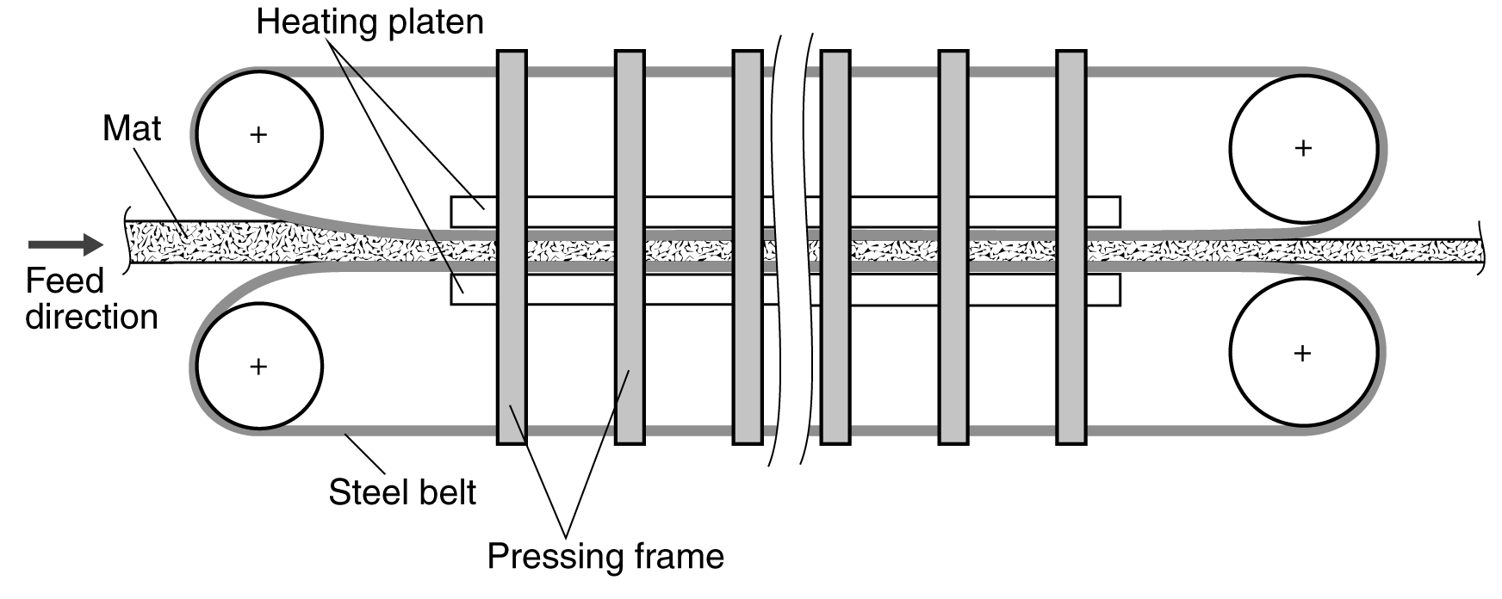
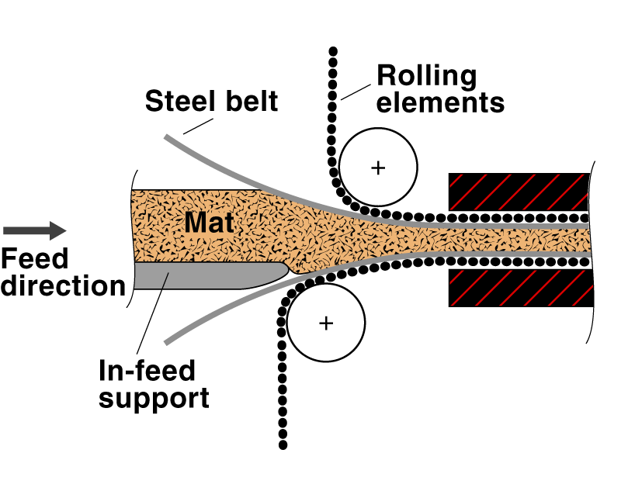
In-feed section

Slide 11
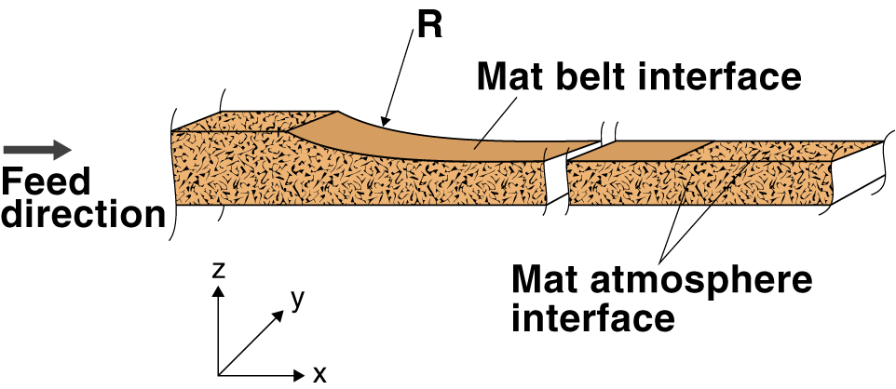
Model Boundaries
Notes:
Our model boundaries are the surfaces and sides of the mat.
Within the press, the mat-belt interface is assumed to be impermeable to gaseous flow;
… at least so far.
Later on it might be interesting to assume gas injection or removal through the steel belt.
But at the moment gaseous flow is only possible through the mat-atmosphere interface, so through the sides of the mat and through the upper and lower surfaces in front of the press and behind the press.
The lower surface of the mat is assumed to be flat …
… while the thickness of the mat at any position within the press results from the defined press pressure.
Or, if we assume that the press is operated in thickness control mode, the thickness profile can be defined directly.
The curvature of the upper steel belt at the press entrance is variable as well and is defined by the in-feed radius R.

Slide 12
THERMODYNAMICS
Thermal conductivity fn. mc, density, direction
Gas permeability fn. density, direction
Tortuosity fn. density
Sorptive energy fn. mc, temp., chemistry
RHEOLOGICAL MECHANISMS
Elastic fn. Density, temp., mc
Delayed elastic fn. Density, temp., mc.
Micro-fracture fn. Density, temp., mc.
ADHESION
Strength rate fn. temp., (mc)
Damage rate fn. temp.
Max. strength fn. cure temp. history
Materials properties (input data)
O
O
C
H
N
C
H
N

Slide 13
Simulation Results
Temperature
Temperature [°C]
Second densification step
Press outlet
Distance from
press entry [m]
Cross-sectional position [mm]

Slide 14
Simulation Results
Gas pressure
Gas pressure [kPa]
Distance from press entry [m]
Width [m]

Slide 15
Simulation Results
Density profile

Slide 16
Mechanisms operative during pressing
Predicting internal conditions
The need to optimize adhesion dynamics
The ABES approach
Adhesion in space and time
Implications
What we will discuss

Slide 17
The need to optimize adhesion dynamics
  Optimize composite product pressing:
    Minimize pressing time
    Reduce energy consumption
    Control emissions
    Reduce material consumption
    Control product structure – properties
Efficiently design new adhesive formulations
Tailor adhesives to new products and processes

Slide 18
Mechanisms during hot pressing
Thermodynamics
O
Rheology
O
Adhesion
C
H
N
C
H
N

Slide 19
Mechanisms operative during pressing
Predicting internal conditions
The need to quantify adhesion dynamics
The ABES approach
Adhesion in space and time
Implications
What we will discuss

Slide 20
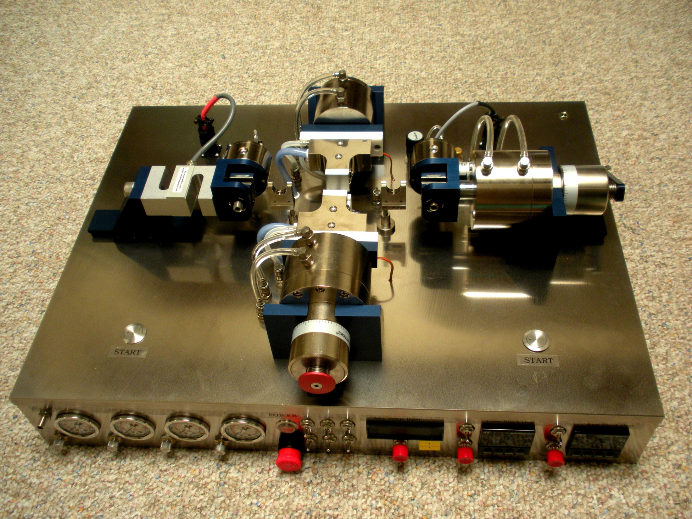
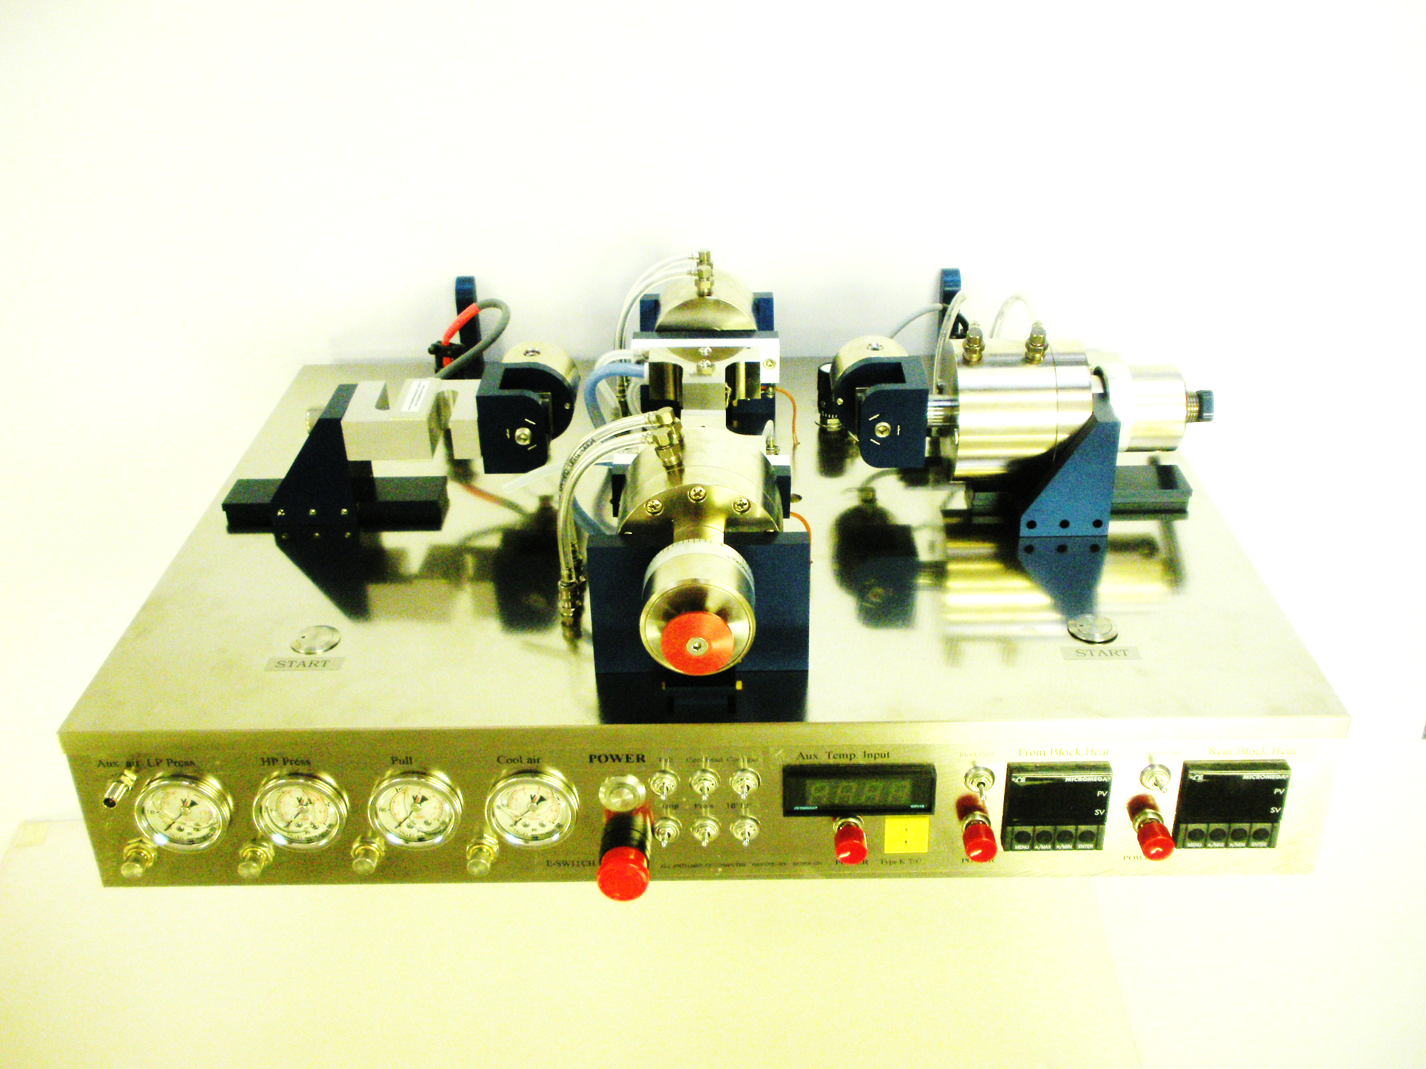
Automated Bonding Evaluation System (ABES)

Slide 21
The approach
Form small tests bond under controlled conditions
Affect rapid heating to target temperatures
Test strength at various stages of cure
Explore isothermal strength development

Slide 22
The bond pressing zone

Slide 23
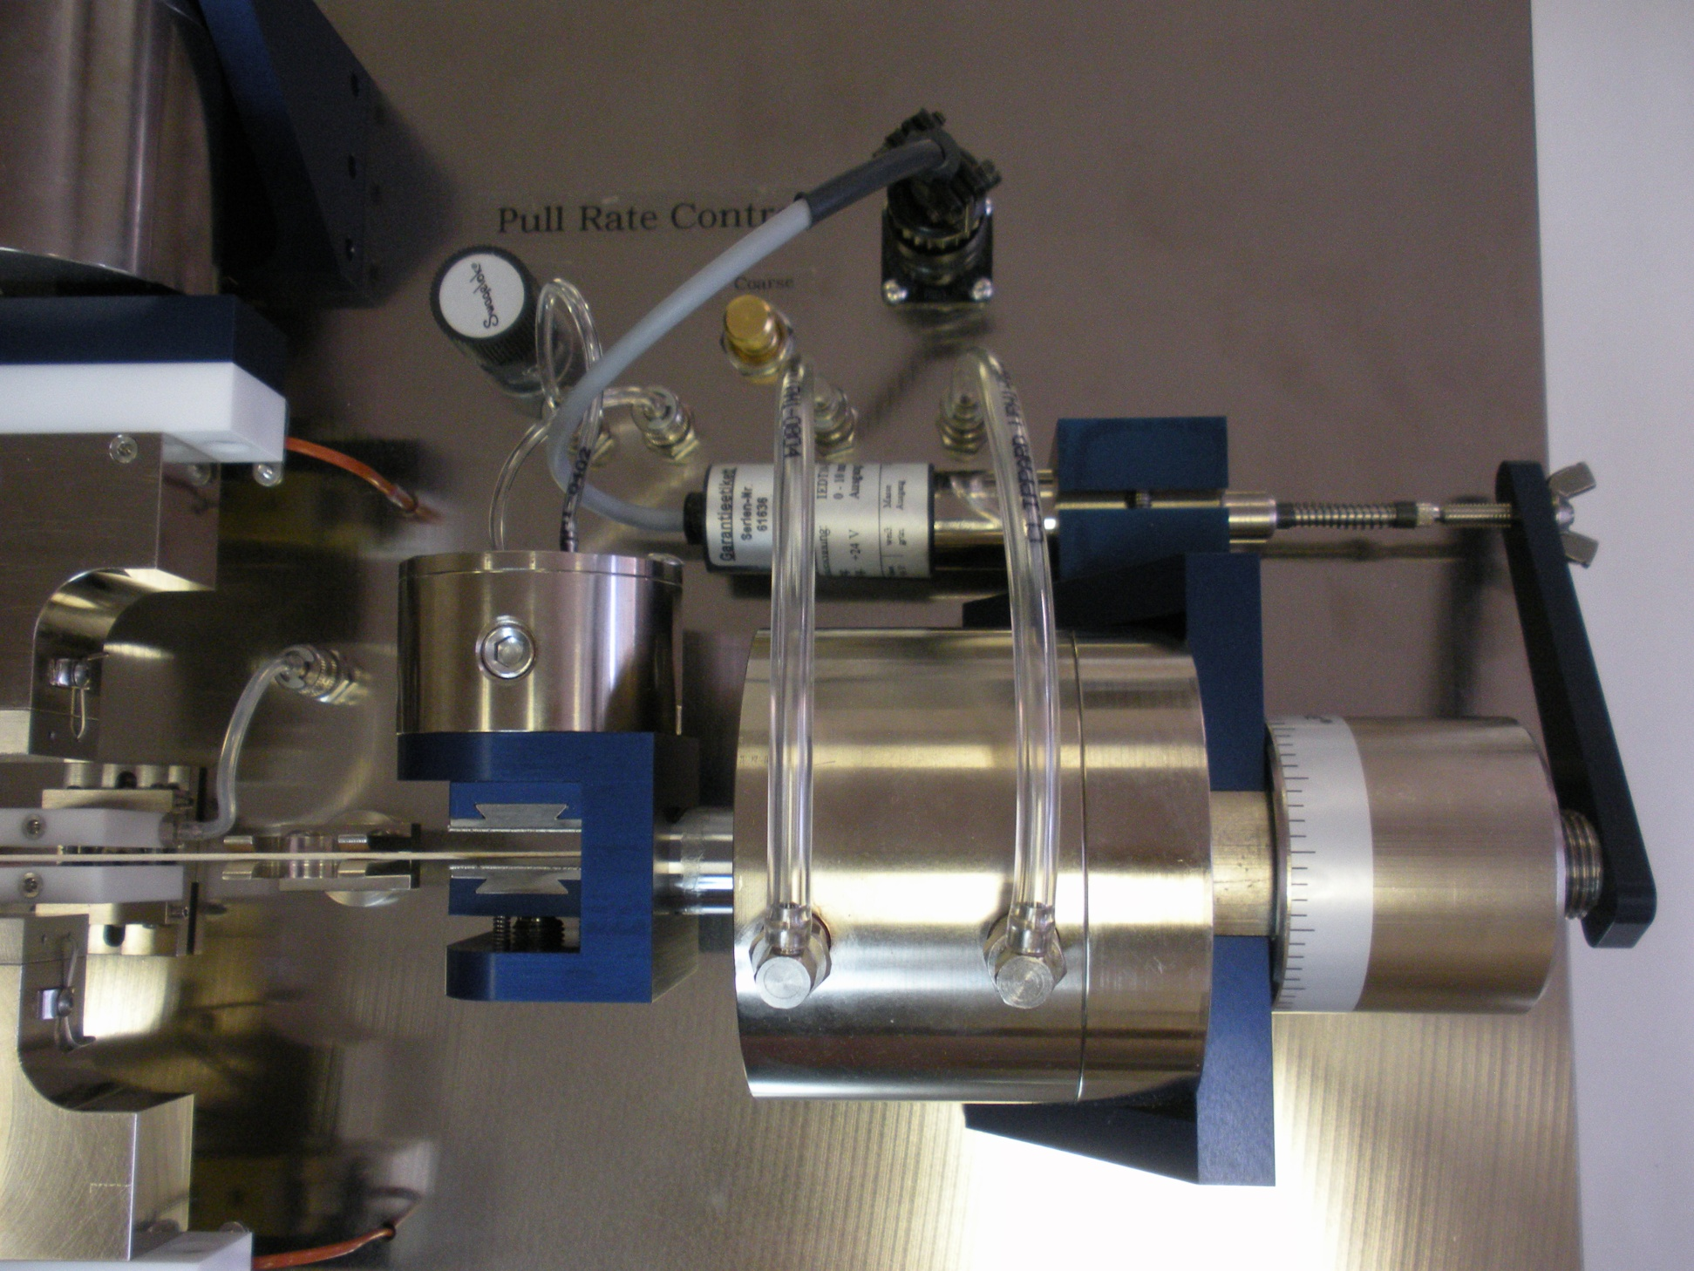
Bond pulling at controlled rate

Slide 24
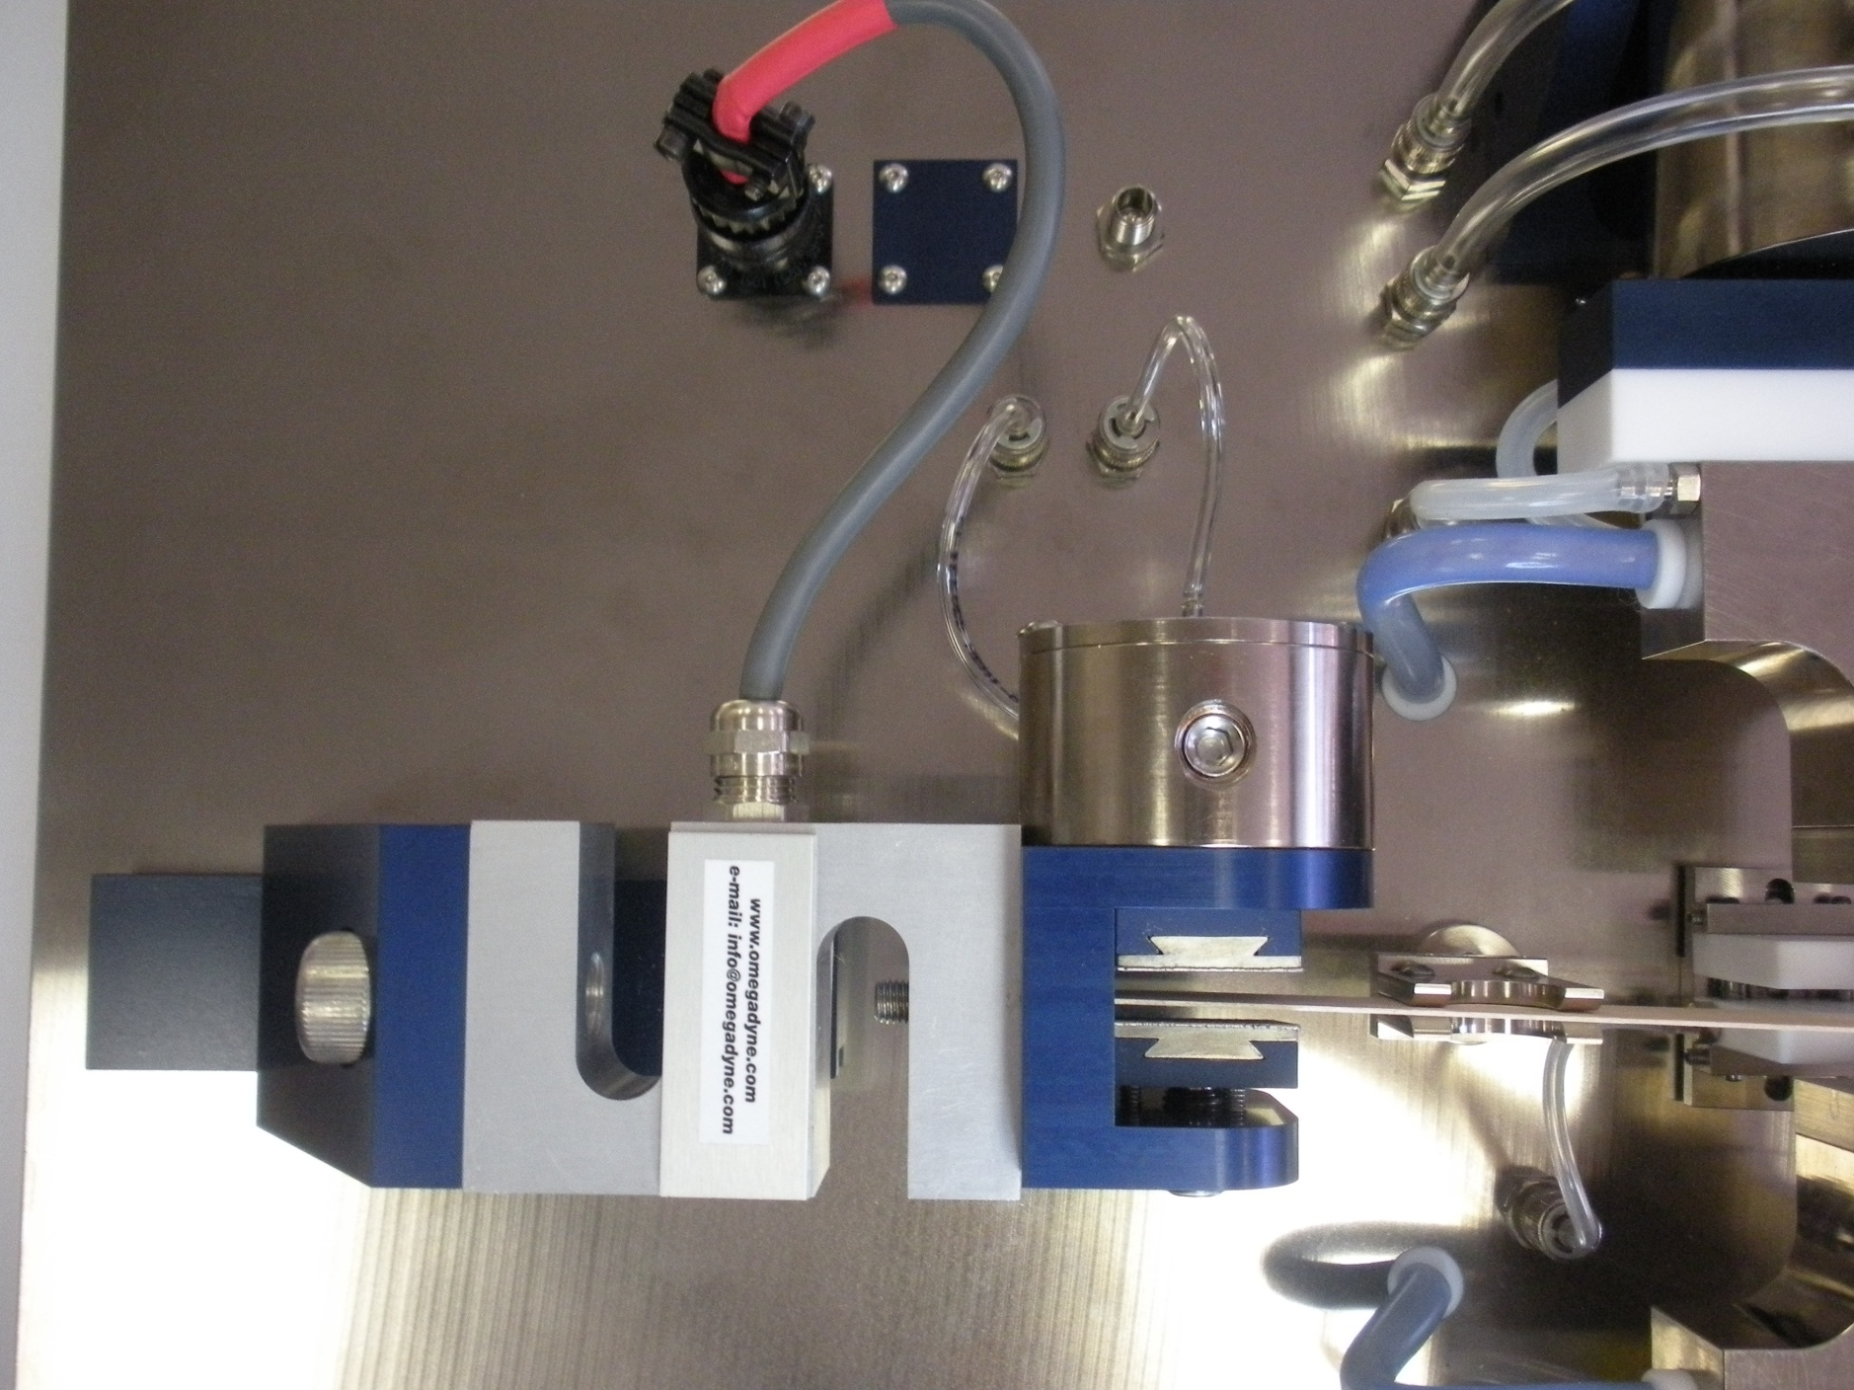
Load measuring @ 2kHz

Slide 25
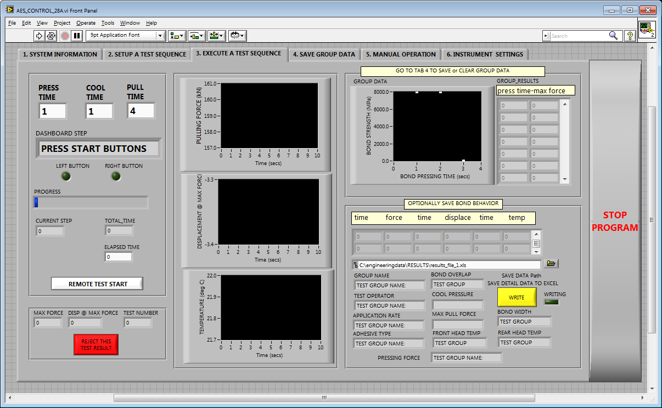

Slide 26
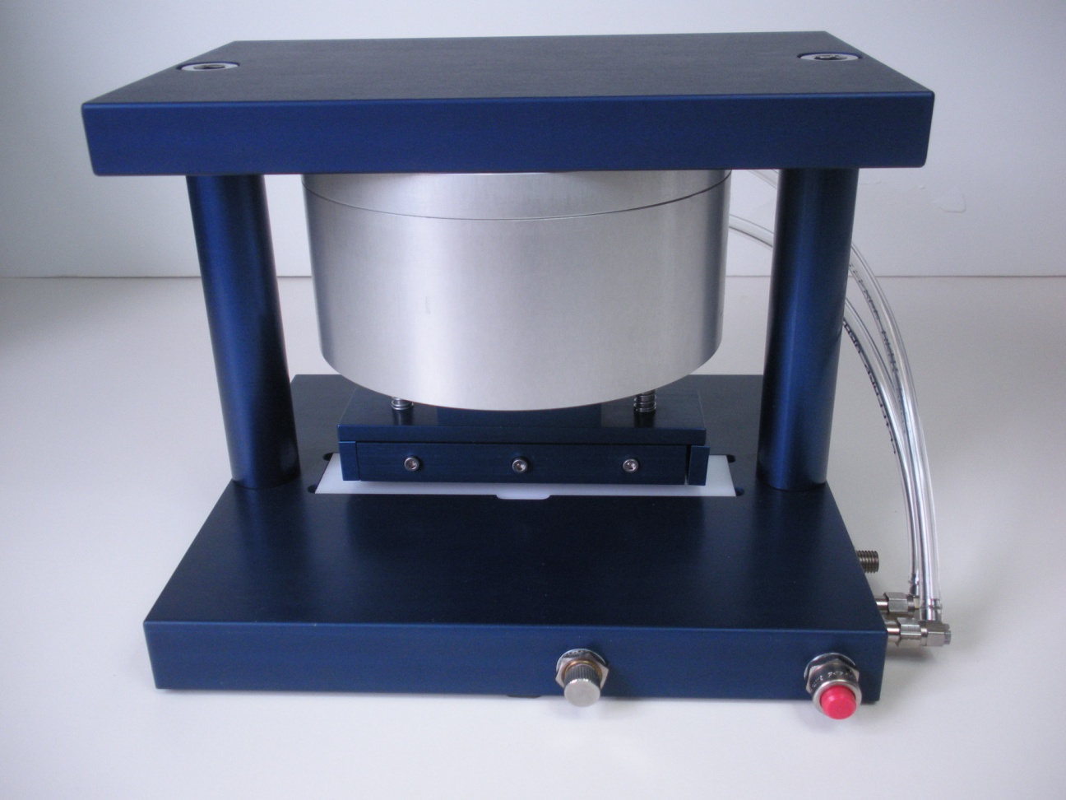
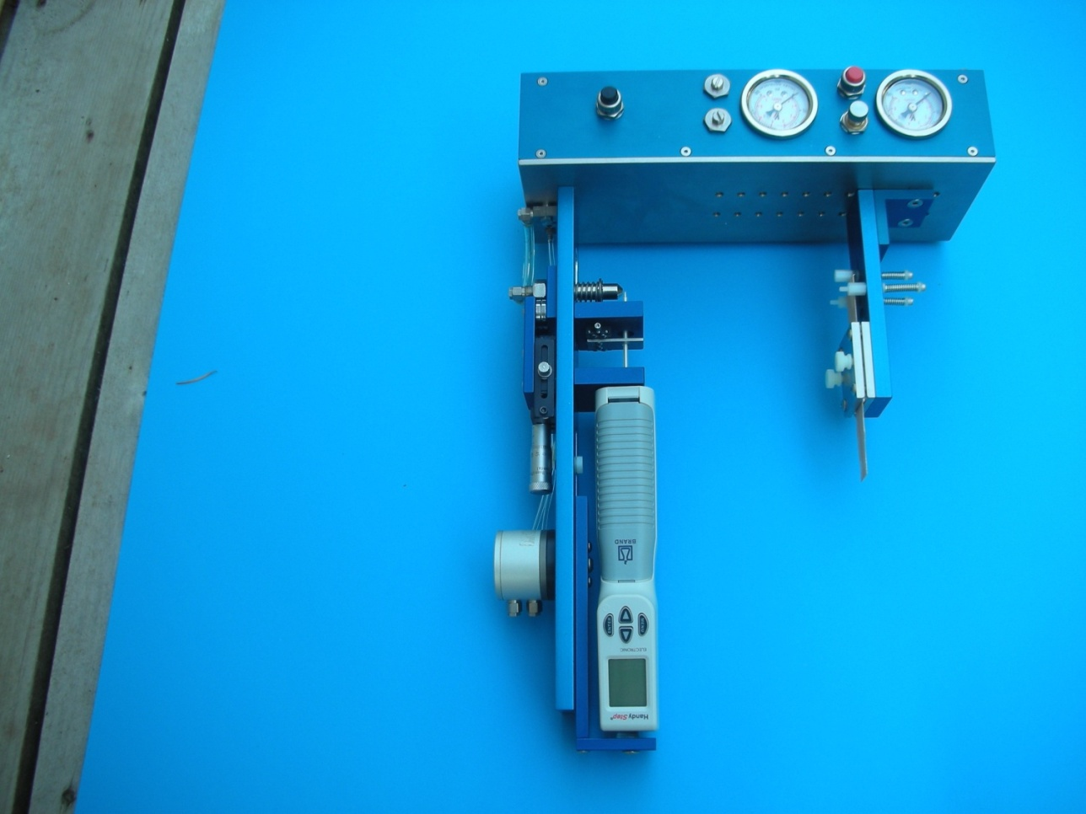
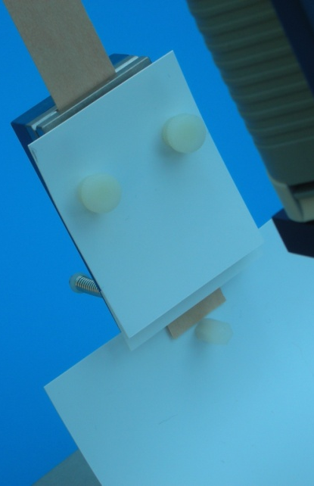
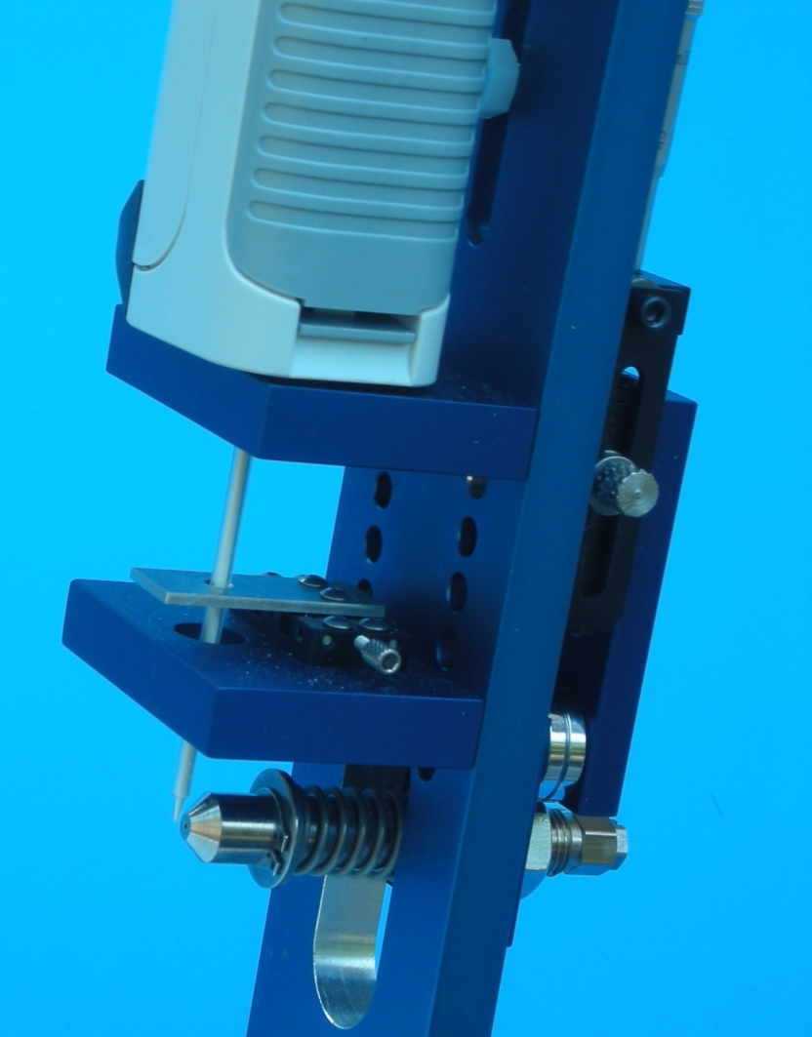
Sample cutting and Adhesive micro-spraying

Slide 27
A typical test bond heating curve
(here: for 110°C head setting)
Glueline Temperature (ºC)
120
100
80
Optional Cooling
60
40
20
0
0
20
40
60
80
100
Bond Pressing Time (Sec.)

Slide 28
Bond strength development plot
(here: for a UF adhesive, 110°C)
Shear strength (MPa)
6
5
4
3
2
1
0
0
100
200
300
400
500
Bond Pressing Time (Sec.)

Slide 29
Isothermal bond strength development for a range of temperatures
140ºC
130ºC
110ºC
Bond strength (MPa)
6
125ºC
95ºC
5
4
3
2
1
0
0
100
200
300
400
500
Bond Pressing Time (Sec.)

Slide 30
Regressed strength development rate versus temperature
200
150
100
50
0
Isothermal strength
development rates (kPa/sec.)
90 100 110 120 130 140
Bond Pressing Temperature (ºC)
strength development rate
temperature
experimentally determined
coefficients

Slide 31
Regressed strength development rate versus temperature
200
150
100
50
0
Isothermal strength
development rates (kPa/sec.)
90 100 110 120 130 140
Bond Pressing Temperature (ºC)
strength development rate
temperature
experimentally determined
coefficients

Slide 32
Mechanisms operative during pressing
Predicting internal conditions
The need to optimize adhesion dynamics
The ABES approach
Adhesion in space and time
Implications
What we will discuss

Slide 33
Simulated temperature development
(here: 28 m continuous MDF press)
Temperature [°C]
Distance from press entry [m]
Cross-sectional position [%]
Mat width: 2.7 m Initial MC (T): 9.6% (26°C)
Target thickness: 20 mm Max. steel belt temperature: 220°C
Target density: 780 kg/m³ Feed speed: 130 mm/s

Slide 34
Simulated bond strength development
(here: 28 m continuous MDF press)
6
4
Bond strength [MPa]
2
Distance from press entry [m]
Cross-sectional position [%]
Mat width: 2.7 m Initial MC (T): 9.6% (26°C)
Target thickness: 20 mm Max. steel belt temperature: 220°C
Target density: 780 kg/m³ Feed speed: 130 mm/s

Slide 35
Mechanisms operative during pressing
Predicting internal conditions
The need to optimize adhesion dynamics
The ABES approach
Adhesion in space and time
Implications
What we will discuss

Slide 36
Balance of desitructive and constructive factors upon press exit (or opening):
Destructive versus Constructive
Trapped vapour pressure Strength of bonds
Residual internal stresses Plastic relaxation
Maximise press speed:
6
4
2

Slide 37
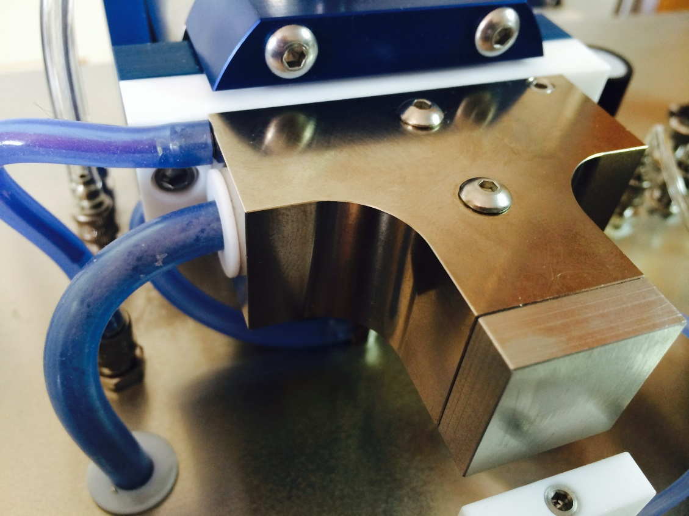
Thermal damage assessment
Up to 265ºC (509ºF)

Slide 38
Bond strength maxima and decline
95ºC
Bond strength (MPa)
6
110ºC
5
125ºC
4
130ºC
3
140ºC
2
1
0
0
100
200
300
400
500
Bond Pressing Time (Sec.)

Slide 39
Bond strength maxima
Strength maxima
95ºC
Shear strength (MPa)
6
110ºC
5
125ºC
4
130ºC
3
140ºC
2
1
0
0
100
200
300
400
500
Bond Pressing Time (Sec.)

Slide 40
Bond strength decline (damage)
Thermal damage
95ºC
Shear strength (MPa)
6
110ºC
5
125ºC
4
130ºC
3
140ºC
2
1
0
0
100
200
300
400
500
Bond Pressing Time (Sec.)

Slide 41
Regressed strength development and damage rates versus temperature
200
150
100
50
0
Isothermal strength
development rates (kPa/sec.)
Isothermal strength
damage rates (kPa/sec.)
90 100 110 120 130 140
Bond Pressing Temperature (ºC)
-50
strength development rate
strength damage rate
temperature
experimentally determined
coefficients

Slide 42
Simulated temperature development
(here: 28 m continuous MDF press)
Temperature [°C]
Distance from press entry [m]
Cross-sectional position [%]
Mat width: 2.7 m Initial MC (T): 9.6% (26°C)
Target thickness: 20 mm Max. steel belt temperature: 220°C
Target density: 780 kg/m³ Feed speed: 130 mm/s

Slide 43
Simulated bond strength development
(showing thermal damage effects at surfaces)
6
4
Bond strength [MPa]
2
Distance from press entry [m]
Cross-sectional position [%]

Slide 44
Simulated bond strength development
(showing thermal damage effects at surfaces)
Bond strength reduction
due to thermal damage
6
4
Cross-sectional position [%]
Bond strength [MPa]
2
Distance from press entry [m]
Cross-sectional position [%]
Distance from press entry [m]

Slide 45
Rapid cooling of partially cured bonds
to explore Tg as a function of cure level
PTFE cooling blocks
Cooling gas supply
Cooling gas supply

Slide 46
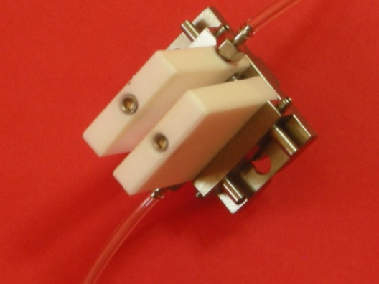
The cool head

Slide 47
Simulation Results
Temperature
Temperature [°C]
Second densification step
Press outlet
Distance from
press entry [m]
Cross-sectional position [mm]

Slide 48
Modelled core bond strength with T_{g} effects included
Press exit: adiabatic cooling with vapour venting
Bond strength (MPa)
6
5
Δ BS
4
3
2
1
0
0
10
20
30
40
50
Distance from press entry (m)

Slide 49
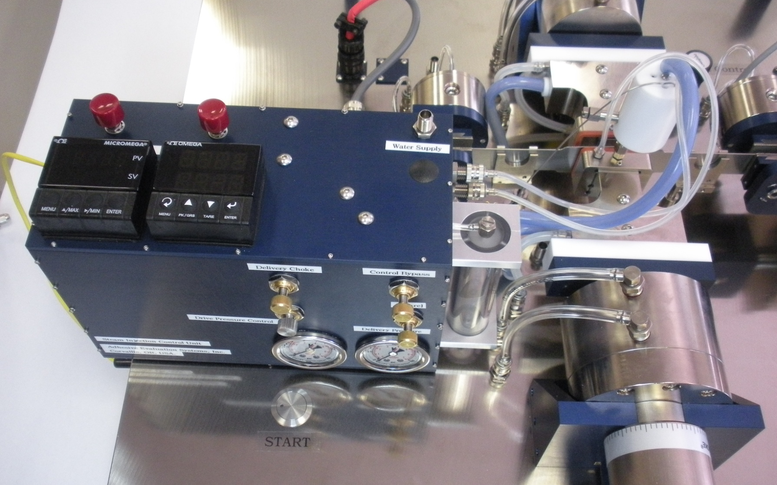
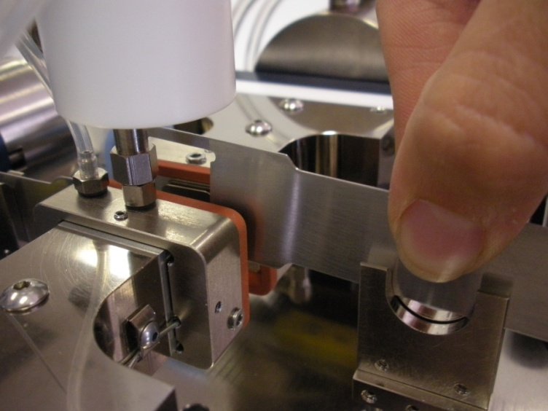
Moisture and catalysis effects

Slide 50
THANK YOU for your attention
Notes:
Our Motivation: Understand mechanisms relevant during consolidation of bio-based materials, ...
... like here in a continuous industrial production.
Prozess kurz beschreiben!
Our interest: Physical processes inside the mat.

